Slide 1
JUQuery
TEAM
18BTRSE031 - T. ASWIN BARATH
18BTRSE026 - SOUVIK KAR
18BTRSE027 - R. SRISARVESH
18BTRSE033 - VYSHNAV RAJ

Slide 2
Table of Contents.
Introduction
Literature Survey
Limitation of the Current work.
Problem Definition and objectives.
Things that User end application has.
Methodology
Gant Chart Diagram.

Slide 3
Introduction.
“JUQuery” is a platform for the purpose of knowing about the academic and unacademic environment, campus life of a student, faculty and student relationship of Jain University in virtual way.
This application provides us with complete information about campus life in student point of view, academic information in college point of view.

Slide 4
It features a familiar and well-thought-out and attractive user interface, much like posting a query, giving a response to a query, helping a student through a peronal chat if required.
A user has a complete freedom to post any query, can also make a funny post in legal way.
Also students can register/ host any campus related events and also can take the feedbacks from other students through this platform.

Slide 5
Literature Survey
Community-based Question Answering destinations enable users to find solutions to complex, point by point and individual questions from different users. Be that as it may, since answering a question relies upon the capacity and readiness of users to address the asker's needs, a huge portion of the questions stay unanswered.
Community-based Question and Answering (CQA) administrations have conveyed users to another period of information dispersal by enabling users to make inquiries and to answer other users' questions.

Slide 6
A fresher just took admission in Jain University, does not know anything about college and even do not have any connection to others. He/ She can directly take our application and can find out his/ her queries. If his / her query is not present then can post his/ her query here.
System will ensure to the students about not to provide any fake answers or events through our site. Student will able to see the live events happening in campus.

Slide 7
The management had full authority to access all details of the customer which are fed into the system. Some security based authentication systems are also present.
With the thoughts our innovation is to provide answers of different question and also notes of different topics made by students from students who are already in Jain University or passed out from Jain University. By that students of JU can come to know their college ralated query and also can trace an event happening in JU through our application.

Slide 8
References
[1] IJTSRD - ANALYZING STRUCTURE OF QUESTION TEXTS TO CHARACTERIZE ANSWERABILITY IN QUORA USING SEO:
A SURVEY Sanjay Soni 1 , Prof. Vandana Navale 2 Dhole Patil
College of Engineering, Pune , India

Slide 9
Limitation of the Current work.
Currently a student who is in college does not have an application where he can interact with the complete college campus in a virtual way.
And also there is no proper medium to get academic related doubts from all around the campus.(ex: Any fresher can directly connect with any senior of the campus and ask his/her doubt)

Slide 10
Limitation of the Current work
A student who is in need of searching for a partner to work on his projects can clearly get that using this application where every students post their achievements and their interests.
A sport person or a music person also can easily connected to other who have the same interest through our application.

Slide 11
Problem Definition and Objectives.
JU Query application mainly focuses on promoting virtual interactions and help each and every student to know what is exactly going in the college campus.
So our application is defined as a software that allows any student to ask/answer any query, post any content, share notes, share their important speeches.

Slide 12
Problem Definition and Objectives.
Our system will be consist of one front end components and a backend componet. Front end component is for students to view the Q&A, to upload Q&A, share notes, register events. The backend component is to store and maintain the data of every student profile.

Slide 13
Things that User end application has.
User Registration and Login : It is the landing page of this application. Here a new user can register or an existing user can login through this page.
Query Section : It has two sub modules called “Ask Query” and “Answer Query”.
Departments : In this module we have partitioned all the departments and also we will add query department wise too. It has many submodules also.
Profile : Here user’s profile will be shown.

Slide 14
Methodology
Platform: JavaScript Web Application
Libraries and Frameworks used:
React
Redux
Firebase API

Slide 15
Methodology
Hardware and Software Requirements:
Pentium-pro processor or later.
RAM 512MB or more
Windows 7(32-bit) or above OS.
Google Chrome browser
Visual Studio Code
Testing: Jest, Cypress, and React Testing Library
Deployment: Heroku cloud server

Slide 16
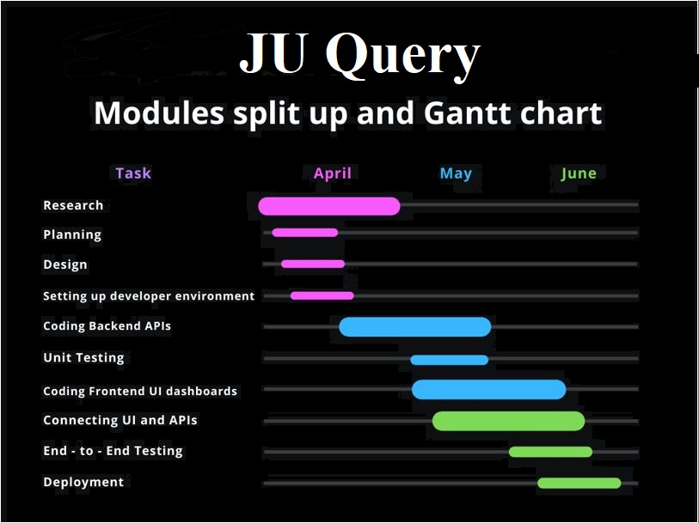

Slide 17
Any Query ?

Slide 18
Thank You :)

